Slide 1
Palliative Care
For
Adults

Slide 2
The approach of the Palliative Care Team is to improve the quality of life of patients and their families facing the problems associated with life-threatening illnesses.
Through early identification
Prevention and relief of suffering,
Impeccable assessment and treatment of pain
Physical, psychosocial and spiritual support.

Slide 3
By the end of this presentation you will:
Have an understanding of your obligations with regard to the care of the dying patient.
Know the five Priorities of Care
Know when and /where to access the Last days of Life Care Agreement (LDLCA)
Know where to access and who to contact for further support.
Notes:
Run through aim of session – 5 Mins Tracey

Slide 4
Palliative and End of Life Care at LNWHT
‘How we care for the dying is an indicator of how we care for all sick and vulnerable people. It is a measure of society as a whole and it is a litmus test for Health and Social Care services’ (DoH, 2008).

Slide 5
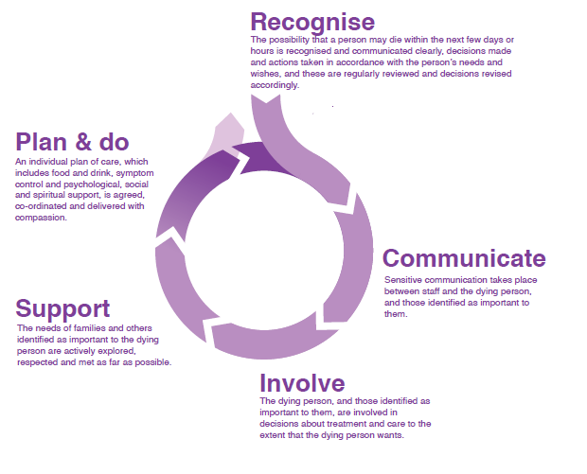
The Five Priorities of Care
Notes:
MFMFMFM

Slide 6
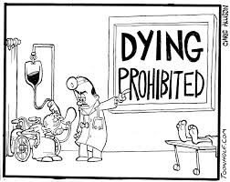
Recognising Dying
The possibility that a person may die within the next few days or hours is recognised and communicated clearly, decisions made and actions taken in
accordance with the person’s needs and wishes,
and these are regularly reviewed
and decisions revised accordingly

Slide 7
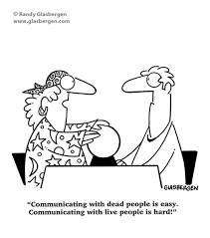
Communication
Sensitive communication takes place between staff and the dying person, and those identified as
important to them.

Slide 8
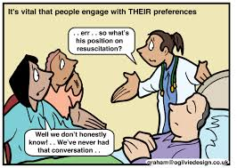
Involve
The dying person, and those identified as important to them, are involved in decisions about treatment and care to the extent that the dying person wants.

Slide 9
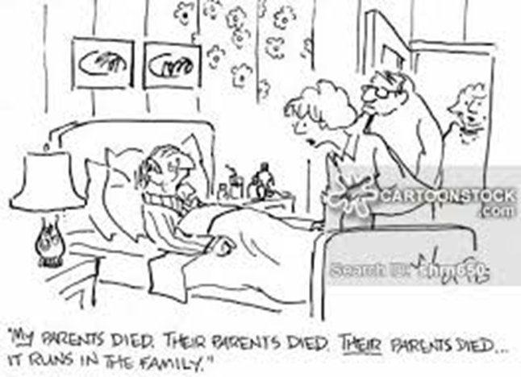
Support
The needs of families and others identified as important to the dying person are actively explored, respected and met as far as possible.

Slide 10
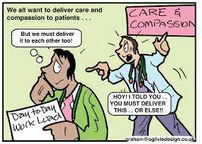
Plan & Do
An individual plan of care, which includes food and drink, symptom control and psychological, social and spiritual support, is agreed, co-ordinated and delivered with compassion.

Slide 11
Last Days Of Life Care Agreement – LDLCA
All wards should have copies of the document ordered through stationary top up. See intranet for guidance.
It should be started when people are showing signs that they are entering the last days of life
Commencing the LDLCA is a multi-disciplinary decision and discussions with the patient should be with someone who knows the patient best.
Discussion with patient and those important to them should happen in a timely manner

Slide 12
Use of Syringe Pumps
McKinley T34 pumps can be used for the delivery of continuous medications via the subcutaneous route
They are recommended when a patient is on an established regime and can no longer take oral medications or has needed more than 2 prn doses in a 24 hour period.
The pumps are set to run over a 24hr period
BD Plastipak syringes should be used. Each ward should have it’s own supply of syringes, giving sets, cannula and batteries

Slide 13
Where to access McKinley T34 Syringe Pumps
Northwick Park and St. Mark's Hospitals - contact the Medical equipment library, Level 4 next to PALS office on x3794
Central Middlesex Hospital - contact site manager
Ealing Hospital – 7 North ward
Notes:
Mentioning returning pumps/ datixing if unavailable

Slide 14
Role of the Specialist Palliative Care Team
Complex symptom control advice
Complex emotional and psychological care
Assistance with complex discharges of palliative patients, rapid discharge home to die
Assistance with care of dying patients with complex needs
Assessment for hospice admission
Guidance with Advance Care Planning (ACP)
Notes:
Fast track criteria, what this means?
Role of hospice
CMC

Slide 15
Specialist Palliative Care Team for NPH/CMH
Acute hospital service
Available 8am to 5pm, Monday to Friday
Submit a referral via ICE
Contact the team at Central Middlesex, Northwick Park and St. Mark's Hospitals on 020 8869 3681
Contact the team at Ealing Hospital on 020 8967 5270 or 020 8967 5260 (bleep 720/490)
Community
For Meadow House, St. Luke’s Hospice and Brent, Ealing, Harrow and Hounslow community teams please use the Specialist Palliative Care (SPC) Community and SPC inpatient unit referral form[docx] 155KB
Call the teams directly if you have any queries at Meadow House Hospice on 020 8967 5179, available 24/7, 7 days a week

Slide 16
Further help and support is available from:
The Macmillan Specialist Palliative Care Team Occupational Therapist (NPH Site) for :
Complex discharges, home access visits, assessing for equipment
Palliative rehabilitation
Goal setting
Symptom control e.g. fatigue and breathlessness

Slide 17
Further information is available from the Trust intranet:
https://weare.lnwh.nhs.uk/end-of-life-care-palliative-care

Slide 18
Or:
Macmillan Assistant Practitioners for support with
Dying patients (LDLCA)
Clinical educational support for ward staff for patients at end of life
Discharge support
Support for Red Bag Scheme

Slide 19
“How people die remains in the memory of those who live on.”
Dame Cicely Saunders

